Slide 1
SRL in drosophila progress slides
Chen Davidyan Krisi

Slide 2
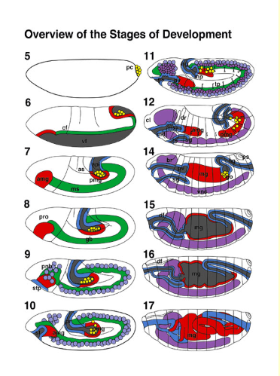
Stages of Embryonic Development
Mesoderm
(amg) (Anterior midgut rudiment; (br) brain; (cf) cephalic furrow; (cl) clypeolabrum; (df) dorsal fold; (dr) dorsal ridge; (es) esophagus; (gb) germ band; (go) gonads; (hg) hindgut; (lb) labial bud; (md) mandibular bud; (mg) midgut; (mg) Malpighian tubules; (mx) maxillary bud; (pc) pole cells; (pmg) posterior midgut rudiment; (pnb) procephalic neuroblasts; (pro) procephalon; (ps) posterior spiracle; (po) proventriculus; (sg) salivary gland; (stp) stomodeal plate; (st) stomodeum; (tp) tracheal pits; (vf) ventral furrow; (vnb) ventral neuroblasts; (vnc) ventral nerve
Atlas of Drosophila Development

Slide 3
Aim 1 – characterize muscular system view in WT
Larva
pupa
adult

Slide 4
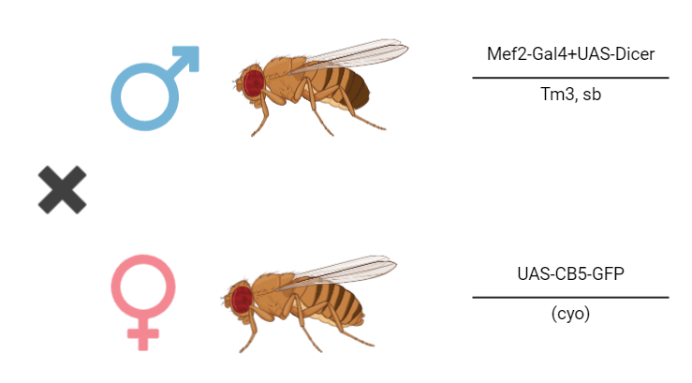
CB5-GFP imaging
F1 were taken at the larval stage for:
Body wall dissection
imaging

Slide 5
CB5-GFP imaging
F1 were taken at the larval stage for:
Body wall dissection
Imaging of body wall muscles
F1 were taken at the larval stage for:
Body wall dissection

Slide 6
calibration
 | 0.2% GA | phalloidin 1h 1:1000 | phalloidin 1h 1:2000
1 | 0.2% GA | X | X
2 | X | phalloidin 1h 1:1000 | X
3 | X | X | phalloidin 1h 1:2000
4 | 0.2% GA | phalloidin 1h 1:1000 | X
5 | 0.2% GA | X | phalloidin 1h 1:2000
6 | X | X | X

